Slide 1
Programming Basics In Python
By: Ariel Arman Woode

Slide 2
Python!
Lesson 0

Slide 3
What is it?
High level interpreted , object-oriented language
Basically, math, English and an absolute godsend
Excellent for beginners
Simple syntax
Intuitive execution
Powerful modern features
Can be used for multiple problems
Considered the Swiss Army knife of programming languages
Fun fact: the name is derived from the English comedy troop, Monty Python

Slide 4
Intelligent Development Environment
Pycharm: A powerful IDE
Does a lot of the heavy lifting
Error checking
Debugging tools
Project management
Is not a magic bullet!

Slide 5
Setup
Download And install Python 3.x
Download and install Pycharm

Slide 6

Code!
>>>print("Hello World")

Slide 7
Interpreted Language
Python reads and executes code line by line.
Is split into two main writing modes:
Scripting
Console

Slide 8
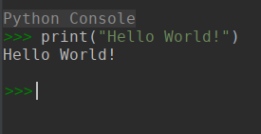
Console
Evaluation
Uses an execution loop
Allows you to interact with your code (try printing new things!)
Great for prototyping
Not so good for longer programs
Return
Read

Slide 9
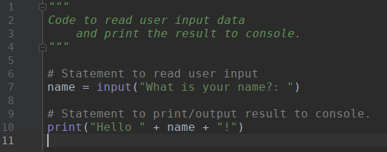
Scripting
FileName.py
Can hold multiple lines of code
Can be saved
Can be rerun
Great for longer programs
Multiple lines
~$: python3 FileName.py

Slide 10
Commenting
Long
comment
A description of a line or block of code.
Good for keeping track of logic.
Makes code easier to read.
Helps others follow along.
Simplifies debugging.
It's good for your sanity.
Just do it, you'll be happier later.
Short
Comment

Slide 11
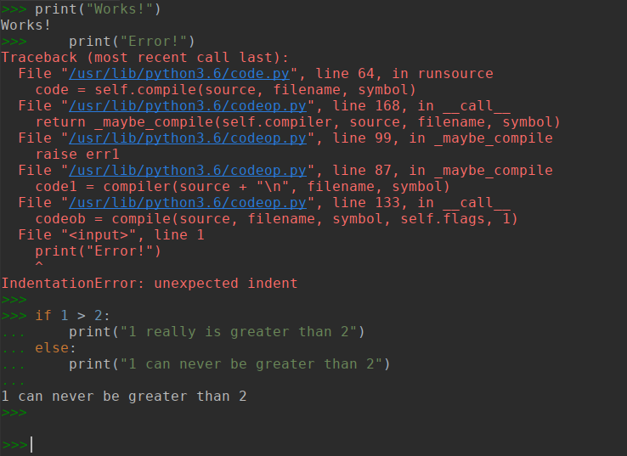
Uses indentation to scope

Slide 12
Errors:
Errors are your friend!
Always read the error report.
If you don't know what it is, Google it!
If you're not getting errors, be afraid.

Slide 13
Because python: I/O
Python simplifies a lot of traditionally tedious operations. One of those operations is I/O (input and output).
It has 3 main functions for this:
input() -> Used to take data from the keyboard
print() -> Used to output data to terminal
open() -> Used to read and write data to a file
You've seen input() and print() in use. Practice using them more to get experience and google them to learn more about them.
open() is a more advanced function. Google it to learn more about it.

Slide 14
Because python: String formatting
Strings are an important data type in many languages and thus are manipulated frequently.
Python simplifies this manipulation of strings in several ways, the most notable of ways is the .format() function.
This allows the user to input some data into a string wherever a '{}' is present in the string.
for example: "hello {}!".format("world") will result in the string "hello world!"
This becomes extremely useful when dealing with multiple data points you need to be in a string.
Play with it to see how it works.

Slide 15
Exercise!
execute `print("hello world!")` in console
execute `print("hello world!")` in file
repeat the previous exercises with `#`’s before the statement (i.e.
`# print("hello world!")`)
what do you notice about the result?
what do you think the `#` symbol has done to the code?
repeat this with the long comment syntax.
use the long comment syntax above this exercise (and every other exercise) to explain what the following lines of code are expected to do.
Bonus!
Try and print at least 5 new lines of text to console.

Slide 16
Exercise!
execute `print(input("Type in a message: "))` in file
What do you notice happening when you run it?
What do you notice different between this and the example on scripting?
How do you make this statement similar to the example?
Bonus!
Try and print at least 5 new lines of text to console.

Slide 17
Data Types
Lesson 1

Slide 18

Everything has a type
>>>type(3)
<class 'int'>
>>>type(3.0)
<class 'float'>
>>>type("3")
<class 'str'>
>>>type(True)
<class 'bool'>
>>>type(False)
<class 'bool'>

Slide 19
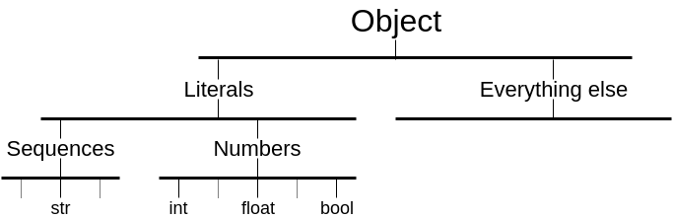
Object tree

Slide 20
Literals are objects … sort of
Have properties
Have methods
Use their value as their reference*
Are immutable

Slide 21
Literal types
Type | Example | Cast
Int | 3 | int()
Float | 3.0 | float()
Str | “3” | str()
Bool | True or False | bool()

Slide 22
Variables
Lesson 2

Slide 23

Everything is a box!
Variable
Assignment
a
1
=
Value
Label
Object

Slide 24
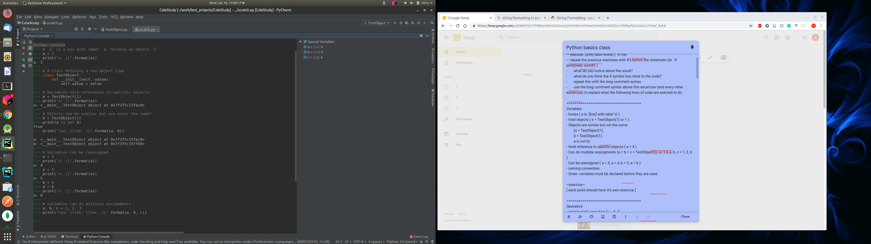
Variables hold objects

Slide 25
Hold references to specific objects

Slide 26
Similar but not the same

Slide 27
Can be reassigned

Slide 28
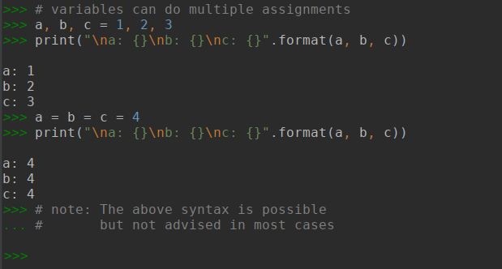
Can do multiple assignments

Slide 29
Naming conventions
A variable name must start with a letter or the underscore character
A variable name cannot start with a number
A variable name can only contain alpha-numeric characters and underscores (A-z, 0-9, and _ )
Variable names are case-sensitive (age, Age and AGE are three different variables)
Source: w3schools.com

Slide 30
Examples
Syntax Error | Bad Practice | Good Practice
Person Record | PRcrd | PersonRecord
DEFAULT-HEIGHT | Default_Ht | DEFAULT_HEIGHT
class | Class | AlgebraCourse
2totalweight | num2 | Total_weight
Source: Python basics

Slide 31
Order
Variable must be declared before they are used
Variables declared earlier remain the same unless reassigned
Variables assigned the value of another variable do not change if the original variable value is changed

Slide 32
Operators
Lesson 3

Slide 33

Exactly what it sounds like
>>>a = 1 + 1
>>>print("a: " + str(a))
a: 2

Slide 34
4 main types
Simple math operators
Programming math operators
Accumulator operators
Comparator operators

Slide 35
Simple math
Operator | Name | Example
+ | Addition | x + y
- | Subtraction | x - y
* | Multiplication | x * y
/ | Division | x / y

Slide 36
Programming math
Operator | Name | Example
% | Modulus | x % y
** | Exponentiation | x ** y
// | Floor division | x // y

Slide 37
Accumulators
Combination of = and another operator
Simplifies variable updates (a = a + 1 : a += 1)
The operator comes before the = ( variable [operator]= value)
Can only be done with a variable
The = assigns the updated value to the base variable

Slide 38
Mechanics
Variable
Operation
a: 1
1
Value
Label
Value
Object
a: 2
Reassignment

Slide 39
Comparators
Operator | Name | Example
== | Equal | x == y
!= | Not equal | x != y
> | Greater than | x > y
< | Less than | x < y
>= | Greater than or equal to | x >= y
<= | Less than or equal to | x <= y

Slide 40
Exercise!
Use your preassigned variables to test out the simple math operators
choose any 2 variables to test an operator.
store the result of this operation in a new variable
print the value of this new variable.
is the value of this new variable what you expected? why/why not?
use this new variable in your future tests.
*****BONUS!*****
use multiple variables in a single operation chain (eg: a + b + c...)
assign the result to a new variable.
Try this with BODMAS as well.
How do the results compare to your expectations?
Use your preassigned variables to test out the programming math operators.
follow the procedure from the above exercise.
Select any of your preassigned variables and test out the Accumulator operators.
print the value of the variable after each test.
Is the value what you expect? Why/why not?
Select any 2 of your preassigned variables and test out the comparator operators.
do these tests in console (eg: >>> a == b)
and then in the file editor (eg: a == b)
what do you notice about doing the tests in either location?
how do you have to change the code to see the results in both cases?

Slide 41
Exercise!
pick any three integer values and assign them to new variables.
for each of these new variables, create two new variables, each assigned the str and float value of that number (eg: a_int = 1; a_str = "1"; a_float = 1.0)
Do this using the type casting methods.
try using these variables to perform the exercises from the previous topics.
what do you notice when you use two different data types?
which data type pairs cause the most trouble?
why? (Hint, read & explain the error reports)
Assign a variable t the value `True` and a variable f the value `False`
print both t and f. what do you see? is this what you expected?
use the comparator operators on these variables, interchanging their positions. (Eg: t == f; f == t; t == t; f === f)
are the values what you expect?
use the simple math operators on these variables.
what values do you see? is this what you expect?
print t and f again and compare the values to the answers you’re getting.
can you explain what is happening?

Slide 42
Milestone!
The Genie in training

Slide 43
Challenge
You are the developer at a magic lamp company. Write a program to create a new genie!
This genie is a junior who just started their training and so only knows how to grant very specific, well defined math-magic wishes.
To practice, they are allowed to grant 5 of these wishes instead of the usual 3 (more powerful) wishes. You can choose which 5 to teach them.
The board wants to see and test the new genie in the next 45 minutes!
BONUS: The board likes theatrics.
Try to make your genie as interesting as possible!
Try to show off the new lamp design that only needs 5 rubs to activate the genie.

Slide 44
Boolean Logic
Lesson 4

Slide 45

True and True is True
>>>True and True
True
>>>True or False
True

Slide 46
4 Boolean operators
Logical operators
Bitwise operators
Membership operators
Identity operators

Slide 47
Logical
Operator | Description | Example
and | Returns True if both statements are true | x < 5 and x < 10
or | Returns True if one of the statements is true | x < 5 or x < 4
not | Reverse the result, returns False if the result is true | not(x < 5 and x < 10)

Slide 48
Truth table
p | q | p and q | p or q | not q
T | T | T | T | F
T | F | F | T | T
F | T | F | T | F
F | F | F | F | T

Slide 49
Identity
Operator | Description | Example
is | Returns true if both variables are the same object | x is y
is not | Returns true if both variables are not the same object | x is not y

Slide 50
Membership
Operator | Description | Example
in | Returns True if a sequence with the specified value is present in the object | x in y
not in | Returns True if a sequence with the specified value is not present in the object | x not in y

Slide 51
Bitwise
Operator | Name | Description
& | AND | Sets each bit to 1 if both bits are 1
| | OR | Sets each bit to 1 if one of two bits is 1
^ | XOR | Sets each bit to 1 if only one of two bits is 1
~ | NOT | Inverts all the bits
<< | Zero fill left shift | Shift left by pushing zeros in from the right and let the leftmost bits fall off
>> | Signed right shift | Shift right by pushing copies of the leftmost bit in from the left, and let the rightmost bits fall off

Slide 52
Exercise!
Try and break each other's brains!
As a class, come up with increasingly complex logical statements using variables and logical operators, starting with the statement: a = 1; b = 1; a == b
Try to resolve the statement and figure out which Boolean value it will take when implemented in console.
Run each new statement in console to see what python resolves it to. Were you correct? Why or why not?
Use several combinations of data types and logical operators, adding on new ones and changing values as you go.
Continue doing this till you have a statement that has all the operators and all the data types

Slide 53
Control Structures
Lesson 5

Slide 54

If this, do that again
>>>x = 0
...while x is not 3:
... if x < 1:
... print("do this", end=" ")
... else:
... print("do that", end=" ")
... print("again")
... x += 1
do this again
do that again
do that again

Slide 55
Basics
used to make decisions in code
Take a condition that results in a Boolean True or False value
Execute the code within the indent scope of the True condition
Can be nested within each other
Take two major forms;
Logical control structures
Loops control structures

Slide 56
Logical
Splits the code into logical blocks hinged on logical conditions

Slide 57
If statements
If [condition]:
#[code block to be run]
Elif [Alternative condition]:
#[code block to be run]
Else:
#[code block to be run]

Slide 58
Try blocks
try:
#[code block to be run]
except [exception]:
#[code block to be run]
finally:
#[code block to be run]

Slide 59
Loops
Runs a block of code for multiple iterations while the logical condition holds true.
Requires an initial value, a logical condition, an update statement and (ideally) a termination condition.

Slide 60
While loop
#[initial state]
While [state-based condition]:
#[block of code to run]
#[update state]
#[initial state]
While [logical condition]:
#[block of code to run]
#[update state]
#[termination condition]

Slide 61
For loop
For [initial state] [sate-based condition] [state update]:
#[block of code to run]
For [place holder variable] in [itterable value]:
#[block of code to run]

Slide 62
Because python: for loops
Many C style languages (languages derived from or similar in sructure to C) have some version of both types of for loops, the most common being the first one known as the "for i" loop.
However, python has no syntax for the classic C style "for i" loop and instead relies on the second style known as the "for each" loop.
There are pro's and con's to this implimentation:
Pro: Traversing iterable data is much simpler this way (why?)
Con: Updating the state of noniterable data (eg: numbers) natively within the loop definition is imposible.
The most common place you'll run into this issue is when dealing directly with numbers.
To slove this, python has an inbuilt function called range() which returns an iterable object of numbers within a given range. Google it and use it to see how it works.

Slide 63
Loop controls
Control | function
Break | Ends the loop regardless of the logical condition or iterative state
continue | An intentional call to move onto the next iterative state.
Pass | An intentional call to do nothing when executed. (most useful as a placeholder)

Slide 64
Exercise!
Try an if / else statement with different logical conditions.
select a condition you believe will resolve to true
make the if block print some statement of your choice and the else block print something else to differentiate the two and show to you which block has resolved to true.
How can you alter the values of the condition (without changing the order) so that it resolves to false?
Try different logical conditions and see how the result of your if / else statement resolves.
Try an if / elif / else statement with different conditions
Create a variable with some arbitrary value.
Use different logical conditions in each if and elif statement that are dependent on the value of this variable.
Use different print statements for each block
Try to change the value of this variable such that each condition is triggered.

Slide 65
Exercise!
Use a loop to implement rub rub rub
remember the code from milestone one? attempt to simplify the lamp by using a while loop.
try it with a for loop.
change the number of rubs in both loops from 5, to 6, to 20, to 100.
how does using a loop simplify this problem? (imagine you had to do it for 100,000,000 rubs)
use a loops to do the times tables
Write a program to take in as input two numbers n and m
Use a for loop to multiply n by each number from 0 to m (n * 0 to n * m)
Print the results to console in the format "{} x {} = {}".format(n, m, ans) where ans is a variable holding the answer for each n * m.
Try this with a while loop as well.

Slide 66
Milestone!
The calculator-inator

Slide 67
Challenge
You're a developer for Calculator Co. They want to try out a new interactive calculator application and have asked you build it for them.
To start out with, they want the calculator to do basic math, exponentiation, floor division and modulus on just two user inputted numbers.
They want the application to ask the user for their desired math command and then take as input two numbers to be worked on.
Each text command should match the math operation it executes and present the result to the user after execution.
The program should continue to run until the user decides to close it with a text input command "close".

Slide 68
Functions
Lesson 6

Slide 69

Hold my code
def addition(a, b): result = a + b return result

Slide 70
Purpose
Used to hold reusable blocks of code
Can be called anywhere in the code using the function name with a "()" in front of it
Runs the code in the function body where the function is called
Rely on the parameters passed into the function call (if parameter are required).

Slide 71
Parameters
Parameters are special "empty" variables that are used by functions to represent the values expected by the function.
These variables are "used" when data is passed into the function at the function call via the parameters.
The values passed into the parameters at function call will be used in the function body where the parameters are used.

Slide 72
Two main types of functions;
Type 1: Functions that return a value
Type 2: Functions that do not.
these functions use the return statement to intentionally pass a value out to the rest of the code.
these functions can be assigned to a variable (why?).
these functions do not pass any of their data outside of the function.

Slide 73
Note: Data creation and side effects
Data can be created and used within a function.
However, that data exists only within the function and cannot be referenced unless explicitly passed out of the function using a return statement.
External data can still be changed by a function even if it doesn't pass out a value.
This is useful in some cases but AVOID this behavior as much as possible to prevent side effects and unintended changes to global variables.
Side effects are changes to data outside the function that may be used by other functions or parts of your program.

Slide 74
Note: useful function tips
To reduce the likelihood of side effects, it's best practice for function not to handle any data input, output (to the user) or do multiple things in a program.
It's best to think of functions in terms of ease of reusability. Namely, if you were going to use a function in a different context, how much of the function would have to be rewritten to fit the new use case?
If something needs to change in a function for a different use case (especially data), try and think of how you can use a parameter to do it.
If some functionality needs to change or behave differently in another context, break it up and write a new function for that use case.
A good function is one that can be used multiple times without needing to change much about how it works.

Slide 75
Because python: function types
Because python is a general-purpose language, it has a few more specialized function types that can be used in more specialized contexts.
Many of these are over kill for the majority of use cases.
However, depending on your context, some of these can vastly improve and speed up program development and runtime.
One of the most popular of these is the lambda function type (google it)
Understanding how to use these and how they work can improve your python code base and knowledge.

Slide 76
Exercise!
Write a function "sum(a, b)" that adds two numbers together
Use a return statement to return the solution.
Assign the function call "sum(1, 2)" to a variable and print that variable.
Did you get the value you expected?
Repeat the last two steps with different parameter values.
Remove the return statement from the function. What happens? Why?
Replace the operations in both previous milestones
Remember your milestones? Go to each one and see where you can replace a block of code with a reusable function.
Determine the type of function to use (type 1 or type 2)
Create a function for this code block and copy the code into the function, modifying it to suite your chosen function type.
Call your functions in place of the code blocks they replace.
Does the code function the same way? Why or Why not?

Slide 77
Exercise!
Create a function using functions.
From the previous exercise, you should have functions defining the add, subtract, divide and multiply operations in your calculator application.
Create a new function "average(a, b)" that adds two numbers, and divides the result by 2 to give you the result. (use operations to do this)
Test the function in console. Does it give you the value you expect?
Once done, use your previously defined functions to rewrite the "average(a, b)" function.
Test the new function in console with the same values you used for the previous version. Does it give you the same results? Why or why not?
Add an "average" option to your calculator and test it to make sure it does what you expect.

Slide 78
Data Structures
Lesson 7

Slide 79

Hold my everything
Random_things = [1, "2", 3.4, True] rgb = ("red", "blue", "green") ages = {"Ari":23, "Asi":20, "Sia":43}

Slide 80
Purpose
Hold multiple data values in a single object or “structure”.
Conceptually: think of them as big boxes or containers with a single label and multiple compartments that can hold many other objects.
There are different types of data structures/ containers and each one has things it can and cannot do, how it holds data, accesses it and where they work best.
Python has a few inbuilt data structures (but these are not the only ones available in CS).

Slide 81
List (or Array)
The most basic and versatile of all data structures in any language (even assembly!)

Slide 82
Description
An ordered collection of objects
Uses an indexing system (starting at 0) for data access
Can be edited
Can have duplicates
Can have different types of objects (common with python but ill advised)
Has its own unique methods
Syntax: random_things = [1, "2", 3.4, True]
Uses square brackets to denote a new list
Is coma separated.
Best use case: can be used in almost any scenario where a data structure is necessary (not always the most efficient though)

Slide 83
Notable functions
Purpose | Function | Description
Adding new data | .append(object) | Adds a new object to the end of the list
 | .insert(index, object) | Insert object at the given index
Searching for data | .index(value, start, stop) | Returns the index of the first object found that matches the value
 | .count(value) | Return number of occurrences of value.
Removing data | .remove(value) | Removes the first occurance of the given value
 | .pop(index) | Removes and returns the value at the given index

Slide 84
Tuple
a type of list that cannot be edited

Slide 85
Description
An ordered collection of objects
Uses an indexing system (starting at 0) for data access
Cannot be edited
Can have duplicates (unnecessary but possible)
Can have different types of objects (useful in some cases)
Has its own unique methods
Syntax: random_things = (1, "2", 3.4, True)
Uses round brackets to denote a new tuple
Is coma separated.
Best use case: when a fixed group of objects is necessary for a given task. Also used for multi-value return statements (a very python thing)

Slide 86
Notable functions
Purpose | Function | Description
Adding new data | n/a | Being immutable, there is no method to add new data
Searching for data | .index(value, start, stop) | Returns the index of the first object found that matches the value
 | .count(value) | Return number of occurrences of value.
Removing data | n/a | Being immutable, there is no method to remove data

Slide 87
Dictionary
The most specialized inbuilt data structure

Slide 88
Description
An unordered collection of objects
Uses a key: value pair system for data access (very important)
Can be edited
Can't have duplicate keys (values yes)
Can have different types of objects
Has its own unique methods
Syntax: random_things = {"v1":1, "v2":"2", "v3":3.4, "v4":True}
Uses curly brackets to denote a new dictionary
Key: value pairs are coma separated.
Keys and values are colon separated.
Best use case: when values have no logical ordering, or you want the fastest direct referencing to specific objects/values.

Slide 89
Notable functions
Purpose | Function | Description
Adding new data | ages[k] = v | Adds a new key "k" to the dictionary with the value "v"
Searching for data | .get(key, default) | Return the value for key if key is in the dictionary, else default.
 | .keys() | Return a list of all keys
 | .values() | Return a list of all values
 | .items() | Returns a set of the key: value pairs
Removing data | .pop(k) | Removes the given key returns its value.

Slide 90
Because python: list indexing
Lists in python are a very versatile data structure that afford many native operations to the user.
Indexing and slicing is one of the most powerful tools available. This is because the syntax for indexing actaully has 3 colon separated variable that can be changed to give different results.
The syntax for this is list[start : stop : skip]
Using the stop and skip positions can allow you to perform many useful list mutaitons, copies and operations that go beyond regular inexing.
Google "Python list indexing and slicing" to learn more or start here to get a good impression of what you can do with this.

Slide 91
Because python: list and dictionary comprehenssion
Operations are often carried out on or with the inbuilt data structures and itterable objects.
To simplify and speed up these operations, python offers unique technologies to do this called List or dictionary comprehension (google it).
Understanding how to use these and how they work can improve your python code base and knowledge.

Slide 92
Exercise!
Create and use a list and tuple
Create a list of any 5 numbers and assign it to a variable.
Do the same with a tuple.
Print both the list and tuple.
Use a for loop to print the individual values of each structure(try it with a while loop too)
Do you notice anything different about them?
Try adding new numbers to both structures using their various functions. What do you notice when you try to do this?
Reprint each value using a loop (hint: put the loop logic in a function to simplify this operation). Do your new values show up where you expected them? Why or why not?
Try removing data from your structures and repeat the loop-print operation in the previous step.

Slide 93
Exercise!
Create and use a dictionary
Create a dictionary of 5 countries and their capitals and assign it to a variable.
Print out this dictionary.
Use a for loop to print the individual values of each structure(try it with a while loop too)
What do you notice about doing this?
Modify this loop to print the key value pairs of your dictionary.
Modify the loop logic further to use the print statement print(k, "=>", v) where "k" and "v" are the "key" and "value" in each "key: value" pair accessed by the loop.
Try adding new data and removing old data from the dictionary and repeating the previous step.

Slide 94
Bonus Exercise!
Create accumulator functions
Remember the accumulator operations? Write a function sum_list(my_list) that takes a list as its parameter, uses a loop to add up all the values of this list and returns the result of the operation.
Test this with a simple list of numbers (eg: test_list = [1,2,3] # 1 + 2 + 3 = 6 ) and make sure the resulting value is what you expect.
Use larger and larger lists of numbers (positive and negative) to test the function.
Try lists with different data types and then with combinations of the data types. What do you notice?
Use a tuple to do test the function as well. What do you notice?
Try a dictionary as well. What do you notice?
Create a modified version sum_dict(my_dict) that can handle dictionaries. What are the things you need to consider for this use case? Can you make the same function handle these use cases?
Create similar versions for lists and dictionaries that use 4 other accumulator operations.
Think about the errors you got doing this exercise. What was the most common source of errors? How could you write the functions to handle these errors better?
Save all these function in a file called Reducers.py and provide long comments for each one describing what it does and how to use it.

Slide 95
Intro To OOP
Lesson 8

Slide 96

We can make it if we try
class LevelClass: def __init__(self, level): self.level = level def level_up(self): self.level += 1 def __str__(self): return "my level is " + str(self.level)

Slide 97
Programming Paradigms
How we tackle problems in CS

Slide 98
Notable Programming Paradigms
Procedural
OOP
Functional
Logical

Slide 99
Object Oriented Programming
OOP: focuses on data representation and code reusability.

Slide 100
Encapsulation
How to take a lot of information and hold or "contain" it in some basic, accessible unit.
That unit in OOP is called an object.
Also used to Hide the internal state of an object. (why is this useful?)

Slide 101
Objects
Objects are the base unit of the OOP paradigm.
Objects make working with multiple/ complex data simpler.
Conceptually, they represent a model of some real-life entity or collection of closely related data points with common functionality.
Objects have two main features: Attributes & Behaviors.

Slide 102
Attributes: Things they know about themselves.
These are data points that best represent the object in question.
You can also see them as closely related information that represent an idea.
These are usually literals, data structures or other user created objects (ie: classes you've made)

Slide 103
Note: Choosing attributes
When thinking about an object's attributes, think about the following things:
What information is useful to define the object with.
What information would be necessary in the program.
How would differences in these values affect the definition classification of an object
Attributes are also called properties or instance variables

Slide 104
Behaviors: Things they can do.
Behaviors are the functionalities extended by a given object.
These are things that we have decided are necessary for object to be useful.
Behaviors are also known as "methods" or functions related only to the given object.

Slide 105
Classes
Classes are used to write the general definition or "blueprint" of a new object type.
Classes put together the components of an object (ie: it's attributes and behaviors), defining what each one is and does.
Classes have a few standard functions, most noteably, the class constructor required to instanciate or "create" a new object of the class.

Slide 106
Structure of a class
Instance varriables
These are the attributes of a given class.
Usully defined at the top of the class.
Constructor
The method used to innitialse a new object of a class.
Python uses def __innit__(self): as the class constructor.
Accessor methods*
Methods used to grant access to an objects instance variables.
Unique methods
The unique functions or behaviours of your object that perform some operation.
These are functions that have access to an objects instance variables.
Utility methods
Methods all classes and objects should generally have.
Tipical exampes: (google their uses)
def __str__(self):
def __hash__(self):
Private/helper methods
Methods/functions inaccessible to the user that may be used in some other function in the class.

Slide 107
OOP concepts
Inheritance
Polymorphism
Abstraction

Slide 108
Code Example
The Book class, the Library class
and package management.

Slide 109
Because python: structure
Python classes are a little weird compared to other langauages most noteably, Java)
Instance variables are defined and initialised within a constructor as oposed to being defiend and initialised separeatly.
Python technicaly has access modifiers (google it) and accessor methods. However, the default way of building a class in python effectively make all instance variables publically accessible (why is this an issue?)
Python uses the "self" key word in classes to say that a function or variable belongs to an object of the class.
These are quirks that are good to keep in mind when shifting to another language.

Slide 110
Because python: Annotation
Python is a dynamically typed language (google "dynamic vs static typeing") and so does not require a variable be predifned with a type before use.
This has it's pros and cons. However, a big con is often poor readability especially with much longer code (as some classes can tend to be).
Not knowing or forgetting the expected type of a variable is a common point of error. Thus, python offers an annotation system to reduce the occurance of these errors.
Annotation syntax is:
var_name: type # States the type of a variable
Def function_name() -> type: # States a functions return type.
It will not make the variable a static type since it has no effect at run time. However, it can make your code a whole lot easier to read when used properly.

Slide 111
Milestone!
The classroom manager

Slide 112
Challenge
You're a developer. Your high school wants to digitize its student records. A major part of this is keeping track of test scores of students in each class. Your high school wants you to build a demo of what such a system would look like for them.
create a console application to:
add new students to a class
remove students from a class
add test scores to each students record
calculate each students average
calculate the class average for each test
generate a report card for each student
To do this, create a student class to encapsulate the attributes and behaviors of a student object.
Use this class in your application to simplify your data concerns.
Bonus!
Create a Classroom class to hold students and give you class wide functionalities (use your discretion)

Slide 113
Algorithm Design
Lesson 9

Slide 114

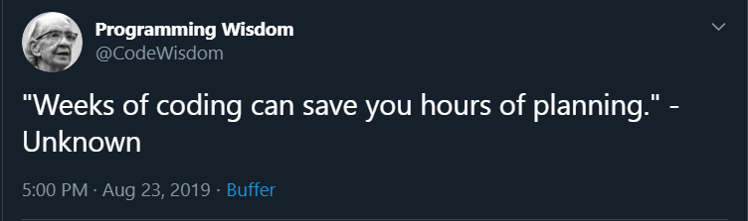
Step 0: think about it

Slide 115
What is it?
The steps taken to solve a problem.
….that's basically it.

Slide 116
Runtime
Runtime is the reletive time it takes a given program to run.
Because modern OS's do multiple things at a given time, using native time as the measure of effiency is not an effective metric (why?)
To get around this, Big-O notation is used to "calculate" the relitive time to completion of a program based on the data and operations used.
Big-O notation is usually written in the form O(N)where N represents the runtime degree.
The details will not be covered in this class. However it is good to know the runtime categories to understand the need for code optimisation.

Slide 117

Notes:
https://developerinsider.co/big-o-notation-explained-with-examples/

Slide 118
Types of algorithyms
Types | Description
Brute force | usually your first (and only) solution
Divide and conquer | break the problem into bits, solve those bits, add up the solutions.
Greedy Method | start with the biggest or best available solution and go from there
Dynamic Programming | remembereing your previous solutions
Backtracking | start with the answer and try to reach the question
Branch & Bound | like greedy but with more foresight
Linear Programming | finding the best solutions by reducing the

Slide 119
Why it's important
Good design speeds up development.
Makes the most of resources.
Redifing a problem as a diffent category can sometimes simplify it significantly.
Algorythim design is a sience with an art to it. Organised code is easier to read.

Slide 120
Milestone!
Hackerrank

Slide 121
Challenge
You're a developer getting ready for a job interview
One of the best ways to do this is to practice your programming skills and knowledge
A good site to help you do this is hackerrank.com
Create an account on hakckerrank and complete your first exercise
Find the python proficiency exercises and do the first few
Try to get to python silver start and attempt other other challenges like the problem solving exercises.

